Slide 1
Word2vec and Negative Sampling
Ali Vefghi
Supervisor: Dr. Rahmati

Slide 2
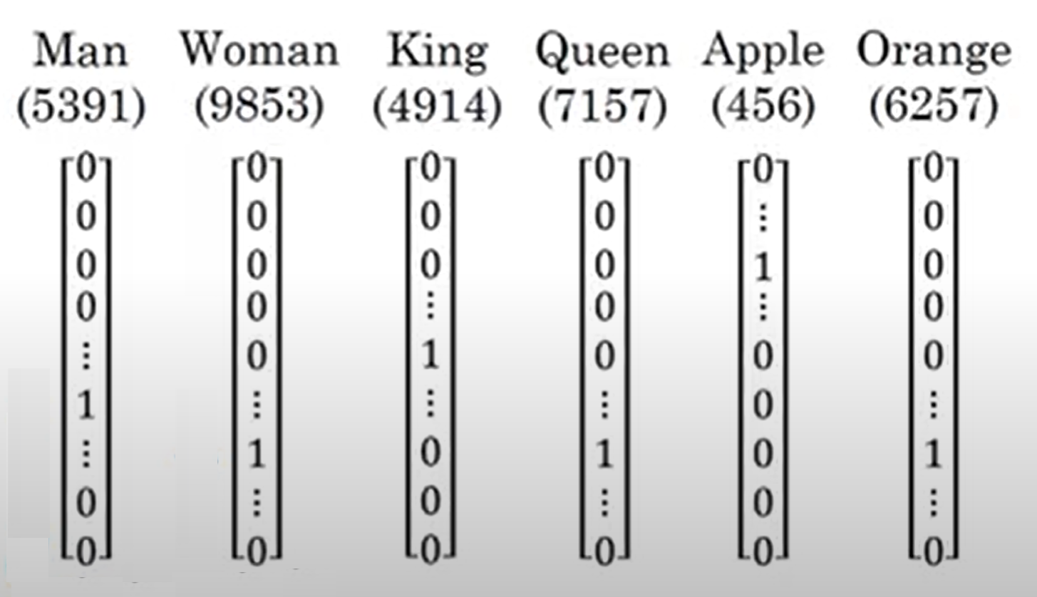
word representation
1-hot representation : O(“Man”)=[0, 0, … , 1, 0, … ,0]
Dict = [a, aaron, …., zulu, <UNK>]
| Dict | = 10000
| O(“Man”) | = 10000
2/18

Slide 3
word representation
Weaknesses:
Can’t generalize across words. For example cant get the relation between apple and orange.
I want a glass of orange ------------. (juice)
I want a glass of apple ------------. (juice)
Too long, sparse and inefficient
3/18

Slide 4
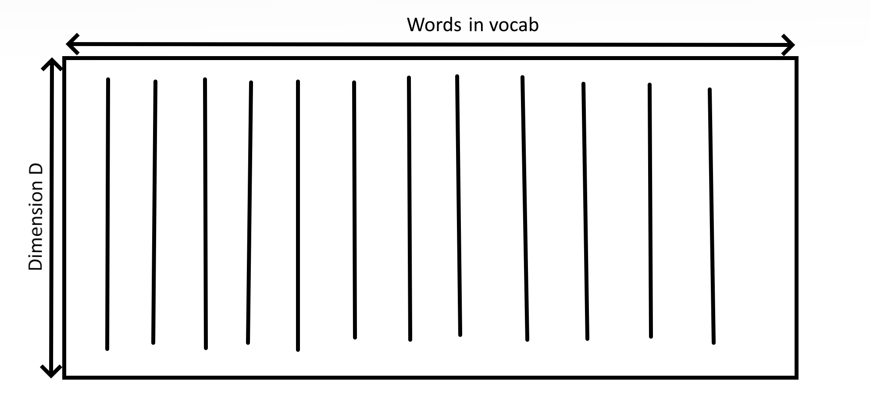
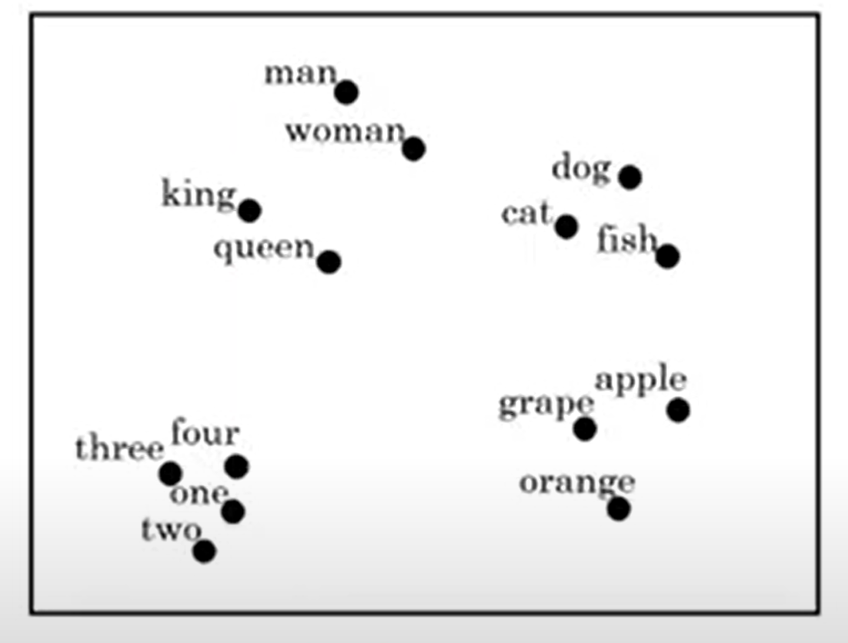
Featurized representation: word embedding
 | Man (5391) | Woman (9853) | King (4914) | Queen (7157) | Apple (456) | Orange (6257)
Gender | -1 | 1 | -0.95 | 0.97 | 0.00 | 0.01
Royal | 0.01 | 0.02 | 0.93 | 0.95 | -0.01 | 0.00
Age | 0.03 | 0.02 | 0.7 | 0.69 | 0.03 | -0.02
Food | 0.04 | 0.01 | 0.02 | 0.01 | 0.95 | 0.97
4/18

Slide 5
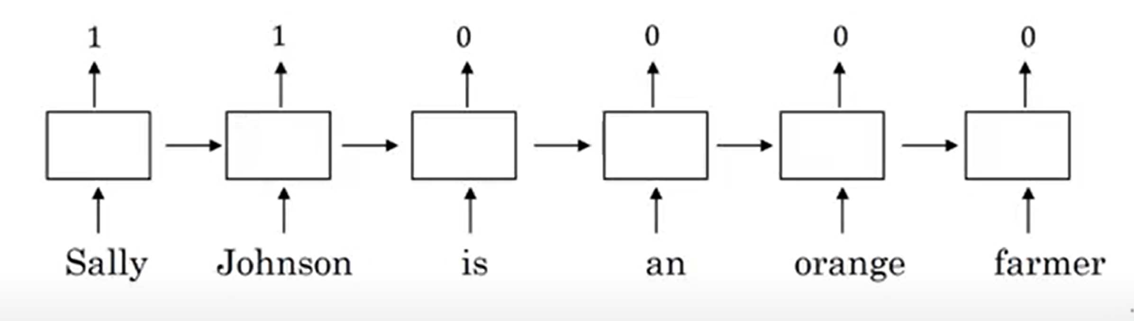
Named entity recognition example
Extracting the names
sally johnson is a person from orange farmer ?
5/18

Slide 6
Transfer learning and word embedding
1. Learn word embeddings from a large text corpus (1-100B words)
(or download pre-trained embedding online.)
2. Transfer embedding to new task with smaller training set.(say,100k words)
3.Optional: Continue to finetune the word embeddings with new data
6/18

Slide 7
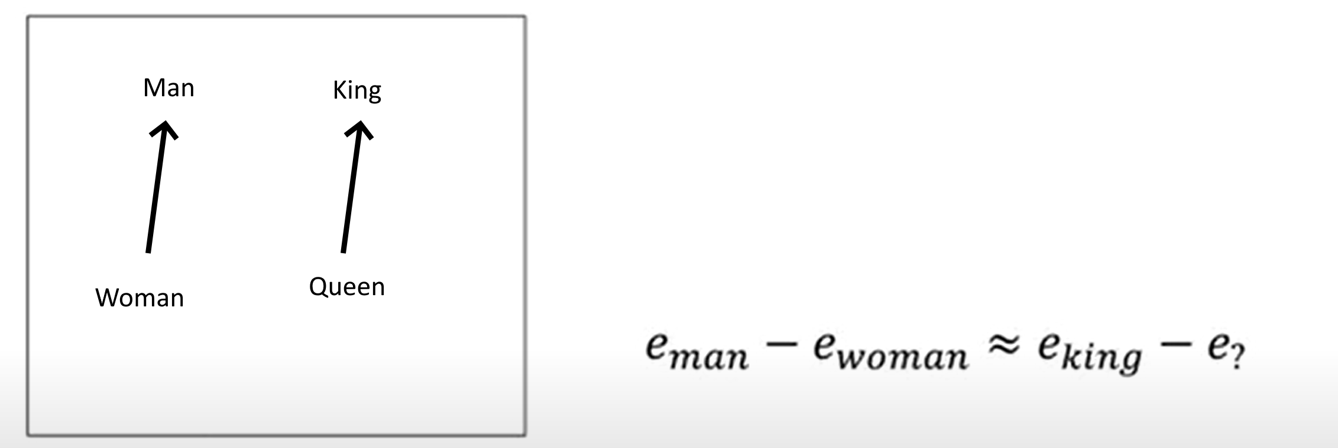
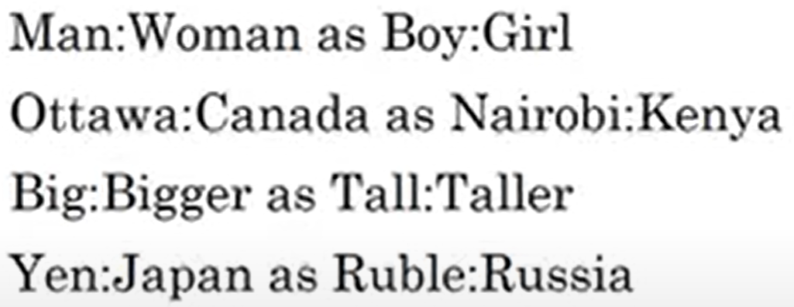
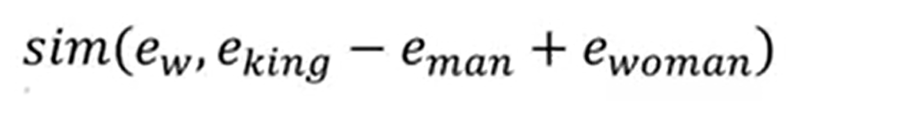
Cos similarity
Need distance to learn with models
7/18

Slide 8
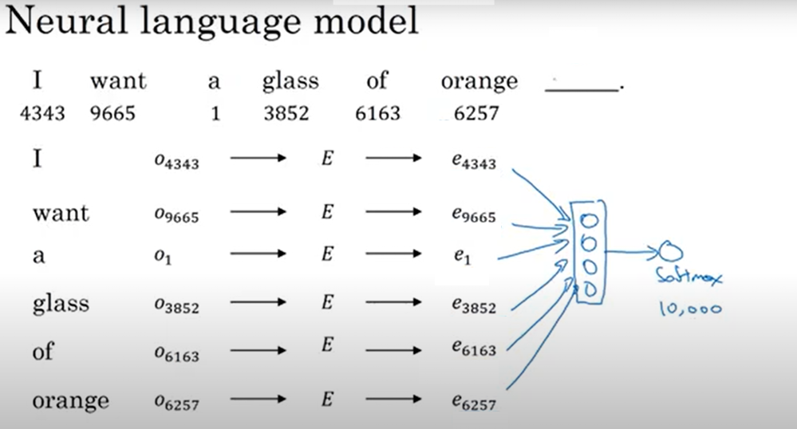
Simple neural network Abstract
8/18

Slide 9
Context/target pairs
I want a glass of orange (juice:target) to go along with my cereal.
Context = last 4 words : a glass of orange ----
Or
4 words on left and right : a glass of orange ---- to go along with
Or
Last 1 word : orange ----
Or
Nearby 1 word (skip-gram) : glass ? ---- ? ?
9/18

Slide 10
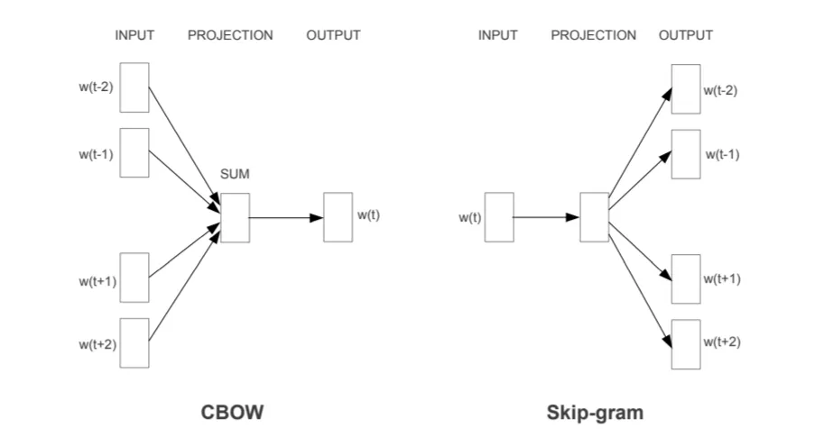
Word2vec
Main idea: The words that appear near each other should have similar word vectors.
Skip-gram: works well with a small amount of the training data, represents well even rare words or phrases.
CBOW: several times faster to train than the skip-gram, slightly better accuracy for the frequent words.
10/18

Slide 11
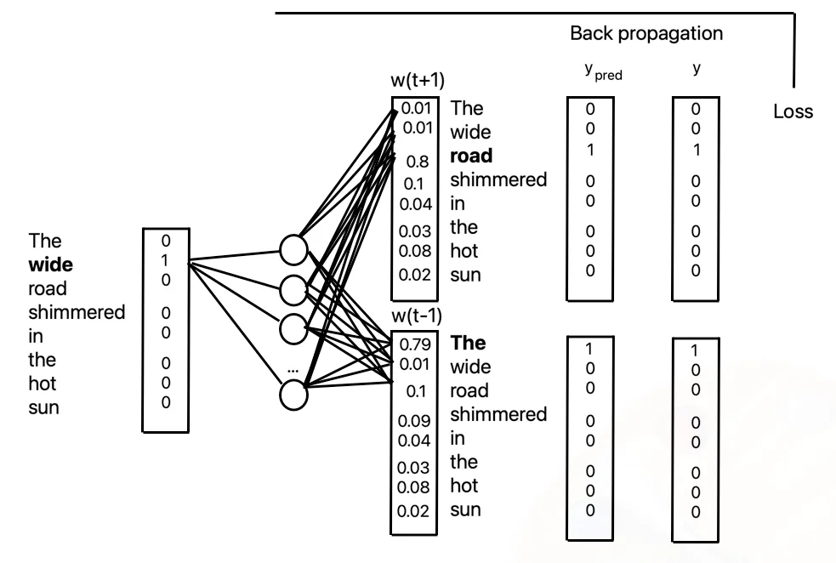
Skip-grams
11/18

Slide 12
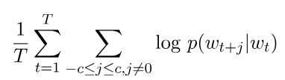

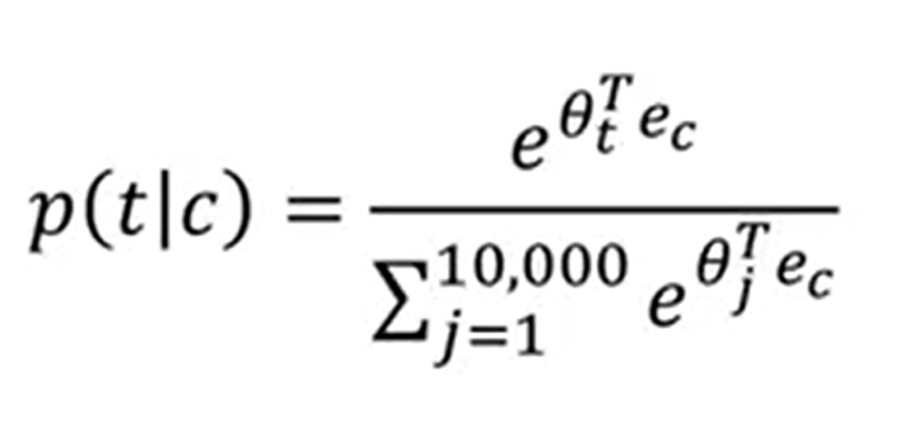
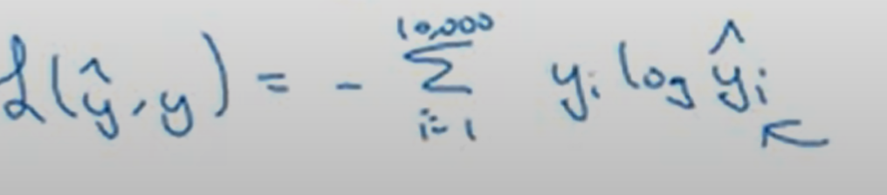
Model
Vocab size = 10000K
Mapping from context c to a target t
e(c) -> softmax -> y^
Tetha(t) parameter associated with output t controlling the distribution
12/18

Slide 13
Problems
For every p(t|c) we calculate the sum in the denomitaor
Hierarchical softmax
13/18

Slide 14
Negative sampling
Maximizing the similarity of the words in the same context
Minimizing it when they occur in different contexts
We do not need to update the entire output weight matrix
14/18

Slide 15
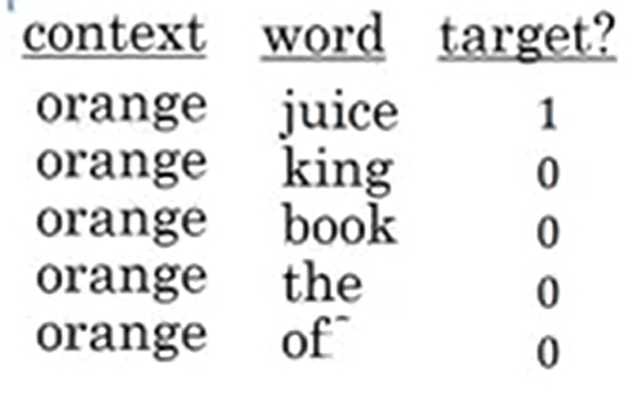
Defining a new learning problem
I want a glass of orange juice to go along with my cereal
Second word is random from dictionary
Of is positive but it is ok to get it negative
How to choose k ( number of neg samples )
K = 5-20 small datasets
K = 2-5 large datasets
15/18

Slide 16
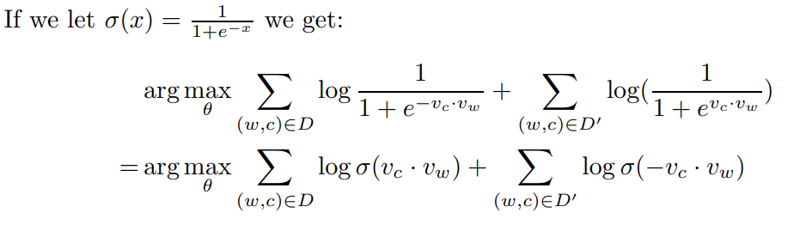
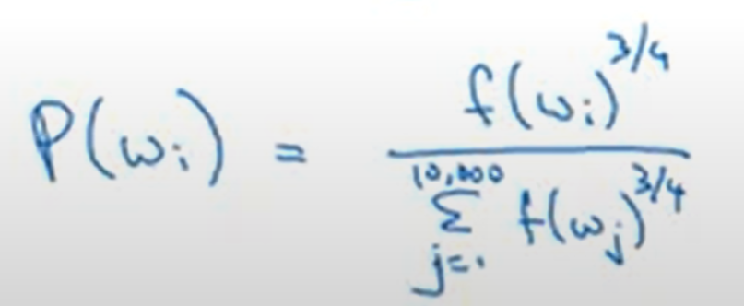
Model
1 giant 10000 way softmax -> 10000 binary classification problem
How do you choose negative examples?
Heuristic:
16/18

Slide 17
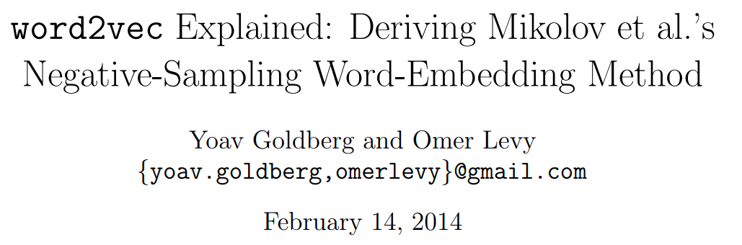
For more information
17/18

Slide 18
Thank you

